Slide 1
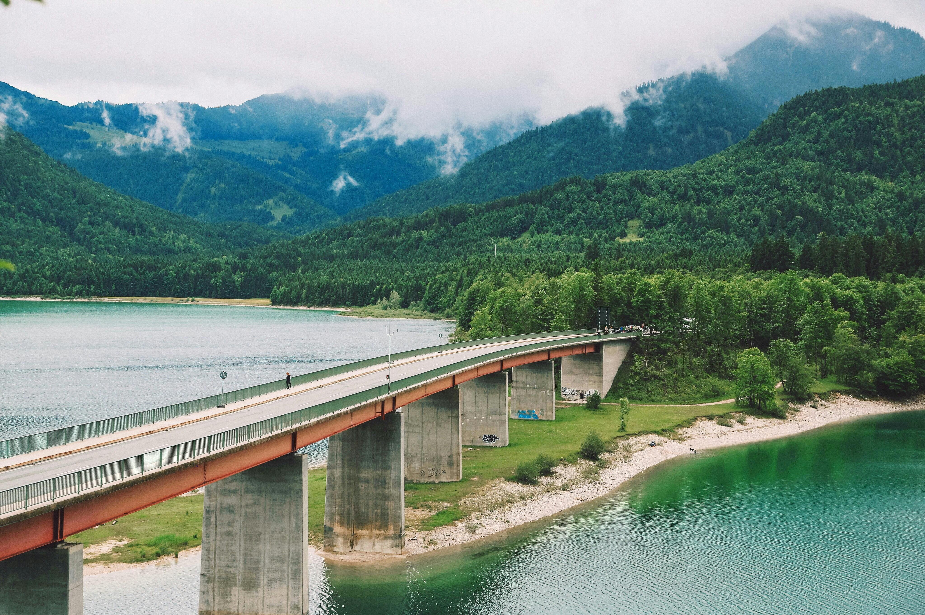
dam selection project by ahmed elzayat

Slide 2
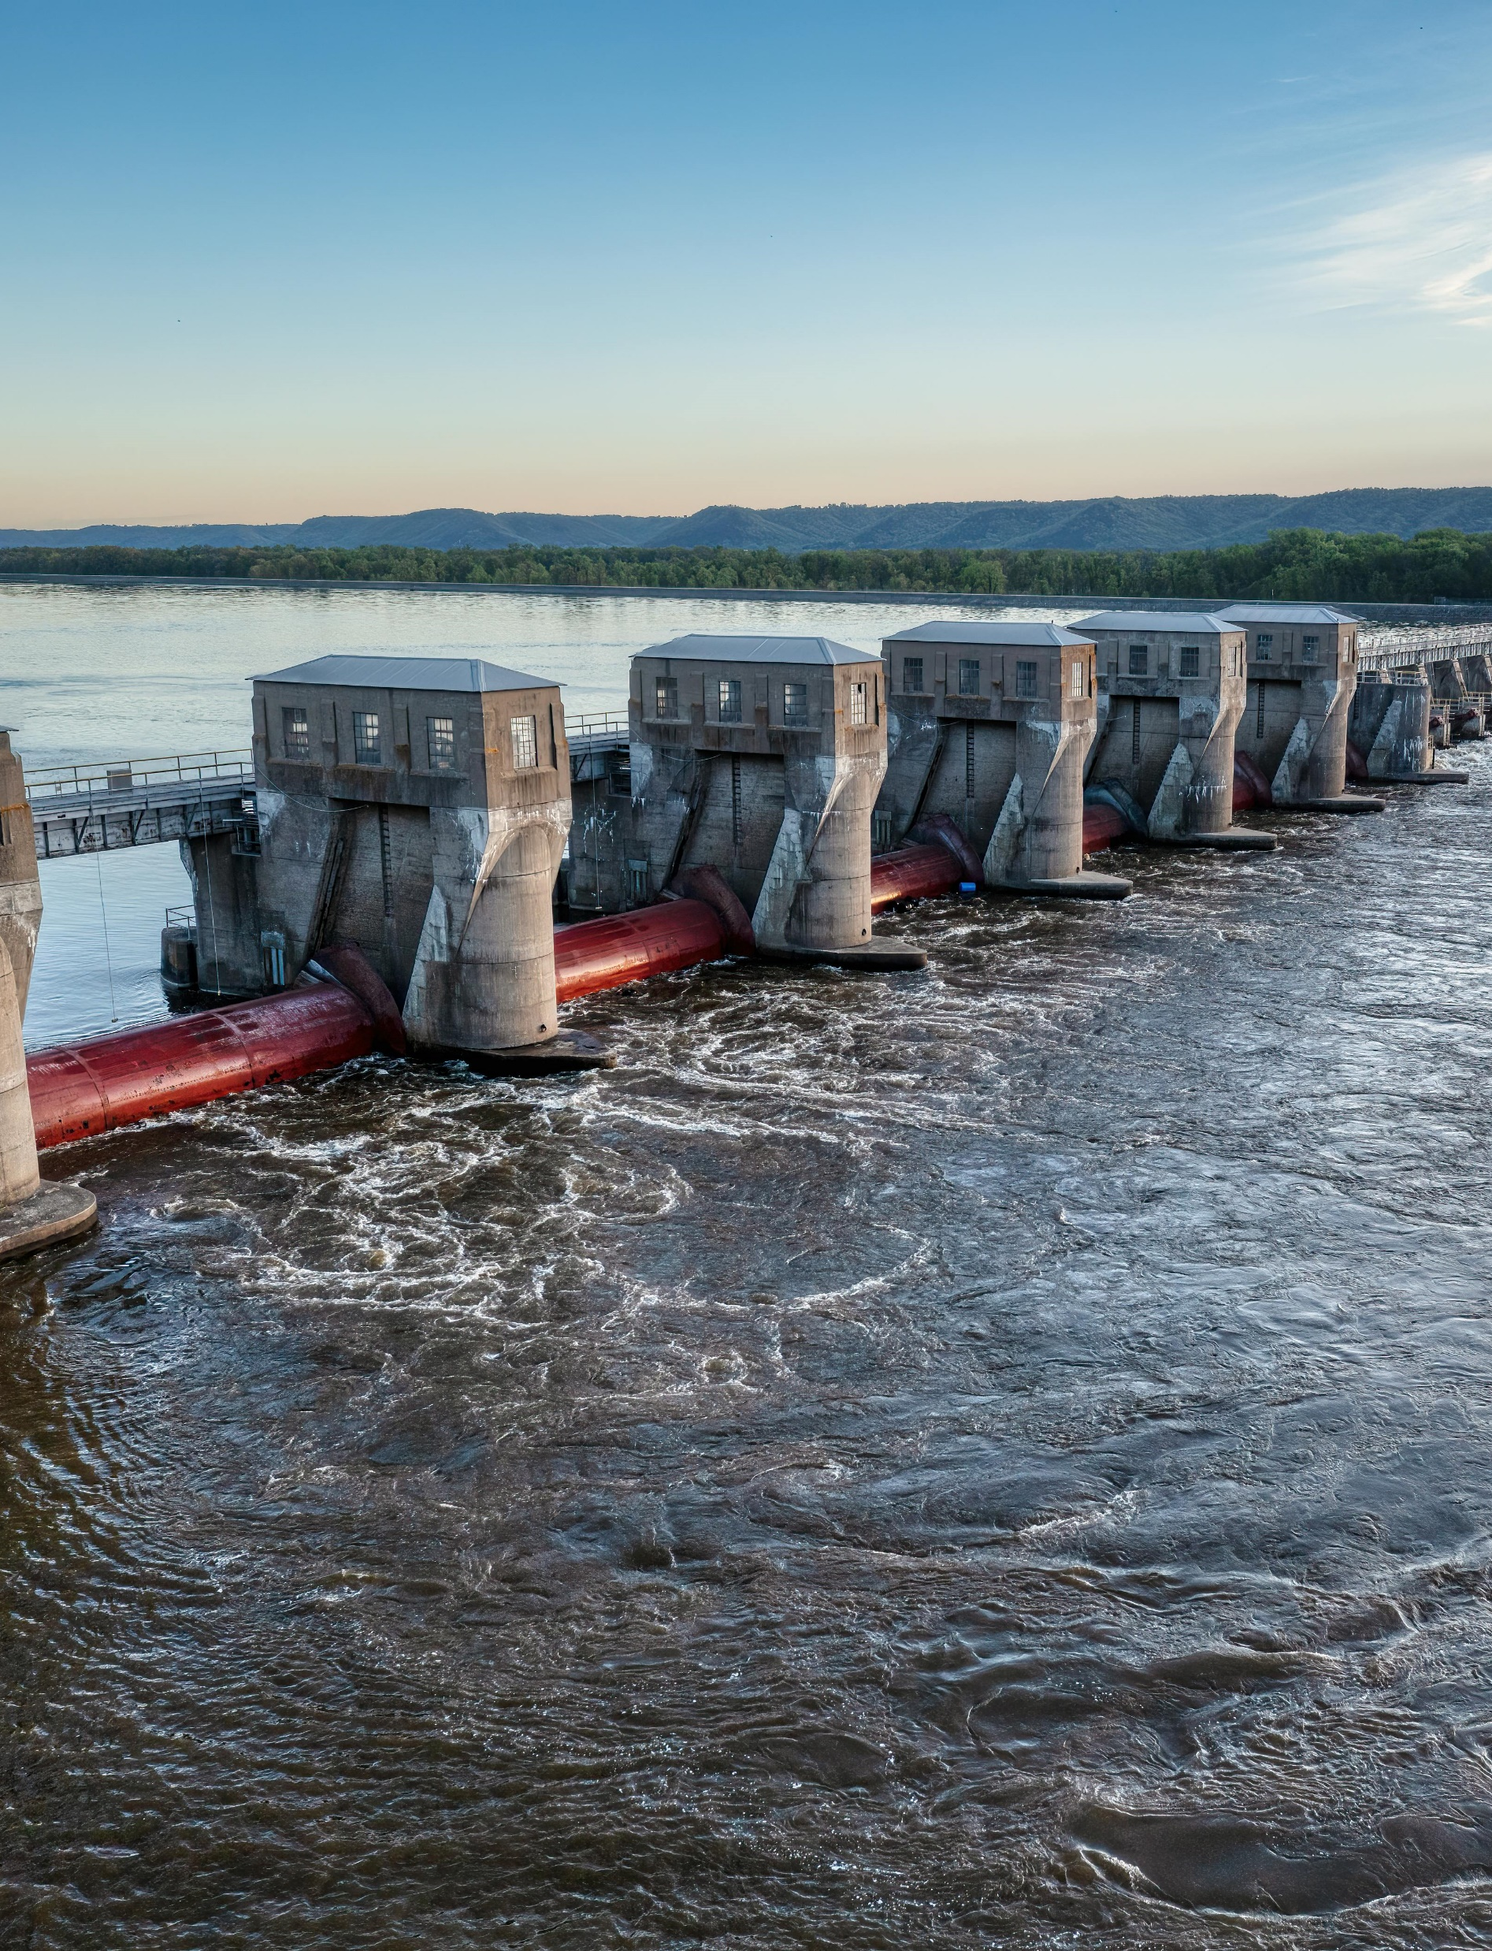
AGENDA
Steps
Recommendations

Slide 3
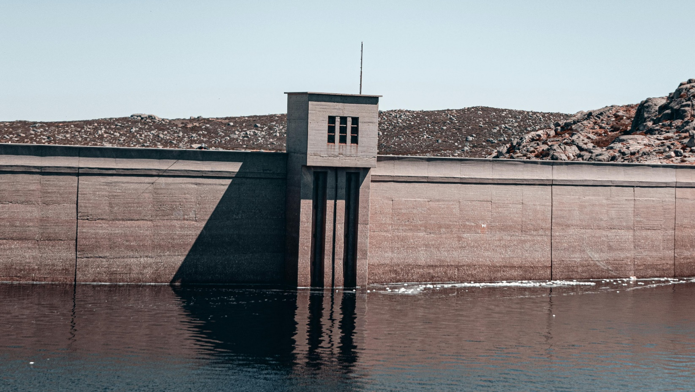
Steps

Slide 4
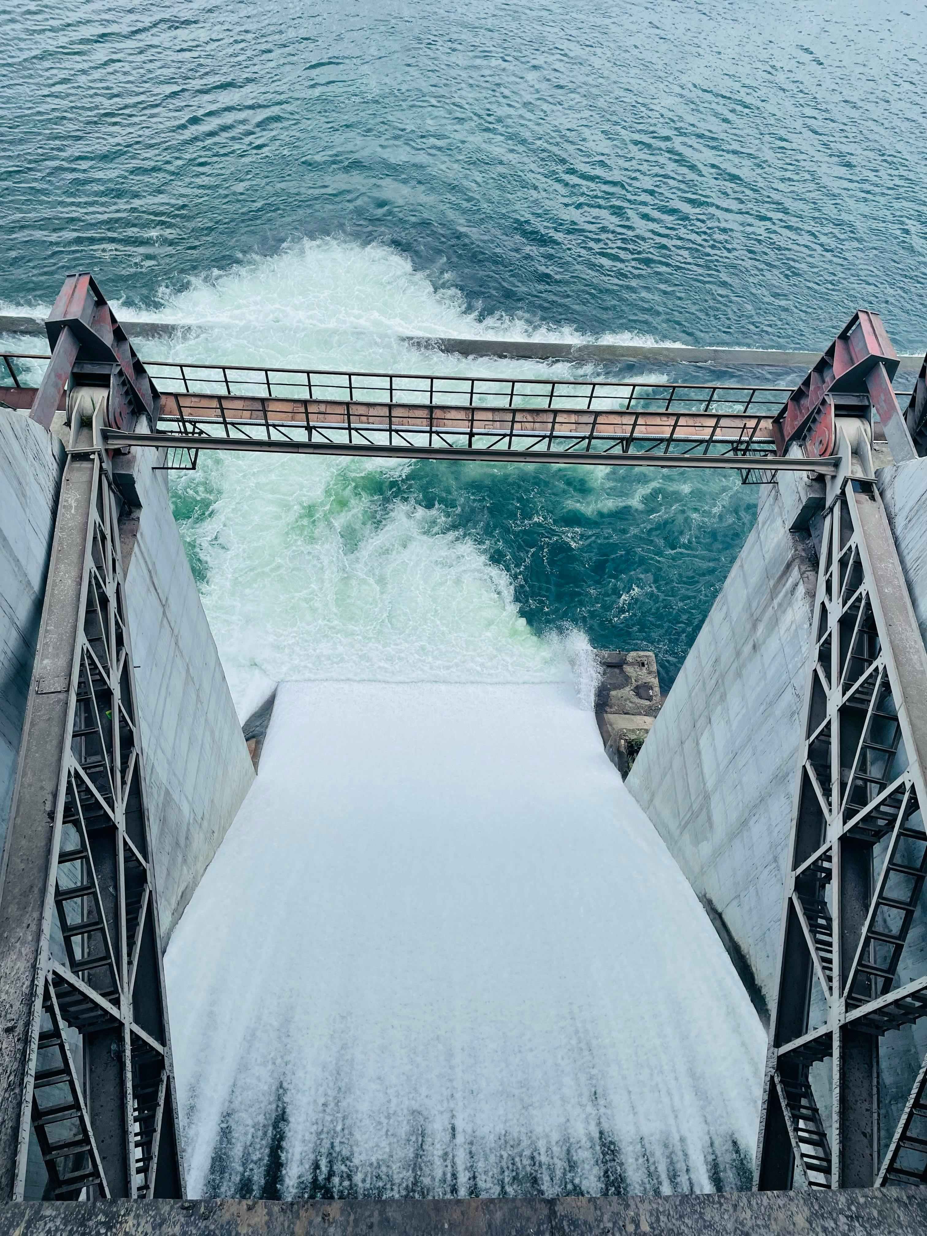
Collect basic data
a. Hydrology data
Water flow speed: This data can be obtained from the Ministry of Water Resources and Irrigation.
Water Rise: Track water levels throughout the year to see how high they are in the proposed areas.
B. Demographic data
Population Density: Get the latest data from the Central Agency for Public Mobilization and Statistics. This data is important to assess the impact of the dam on local communities.
C. Environmental data
Environmental Studies: Includes the impacts of dam construction on the local environment and river ecosystem.

Slide 5
Analyze data using ArchMab software
a. Data Entry
Enter all collected data into ArchMab software.
B. Perform analysis.
Evaluate:
The storage capacity of the dam: based on the height and speed of water flow.
Environmental Impact: Assess the potential impact on the environment and ecosystem.
Socio-economic impact: Analyze the impact of the dam on local communities in terms of potential displacement and economic benefits.

Slide 6
Feasibility assessment
a. technical feasibility
Ensure that the proposed location can support the required infrastructure for the dam.
B. Financial feasibility
Calculate construction and maintenance costs and compare them with the expected return from electricity generation and water storage.
C. Environmental and social feasibility
Final assessment of the environmental and social impact and providing solutions to reduce potential negative impacts.

Slide 7
Providing recommendations

Slide 8
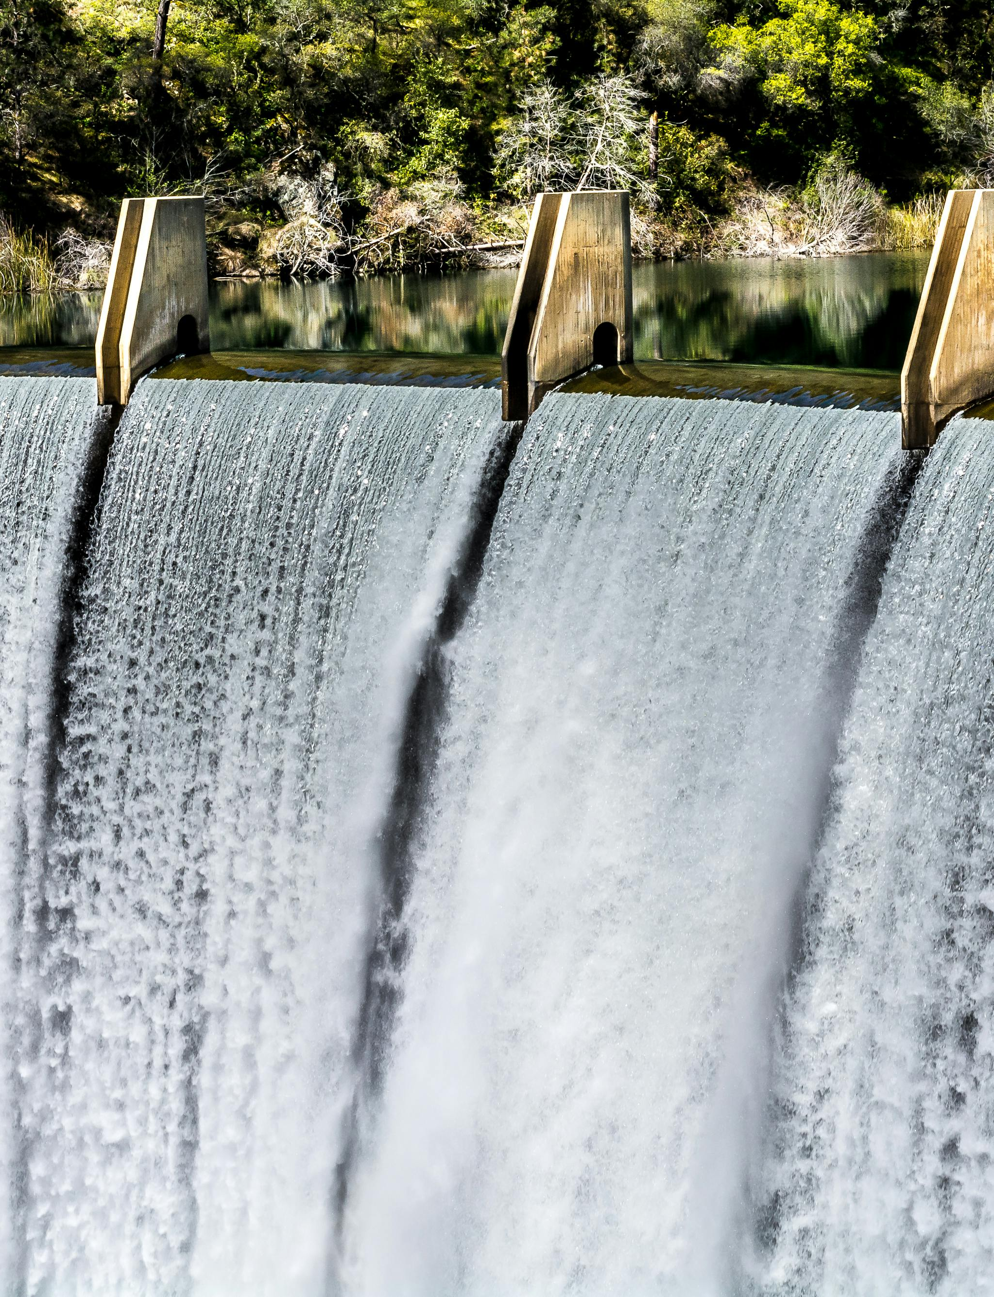
Providing recommendations
Based on the analysis:
I recommend building the high dam in Luxor because:
It will distribute and regulate the flow of river water to the New Valley area.
The New Valley area has a wide desert, and when the dam is built, it will lead to several benefits, such as:
Water storage: Dams can be used to store water useful for irrigation, industrial and civil uses.
Electrical power generation: Water flow from the dam can be used to generate electrical power, which contributes to meeting the energy needs of the region.
Economic development: Building dams can contribute to enhancing economic development in the region by supporting agriculture and industry and creating job opportunities.
Improving the environment: Dams can be used to regulate water flow and improve the environment surrounding an area, such as creating new water spaces for wildlife and improving water availability for local communities.

Slide 9
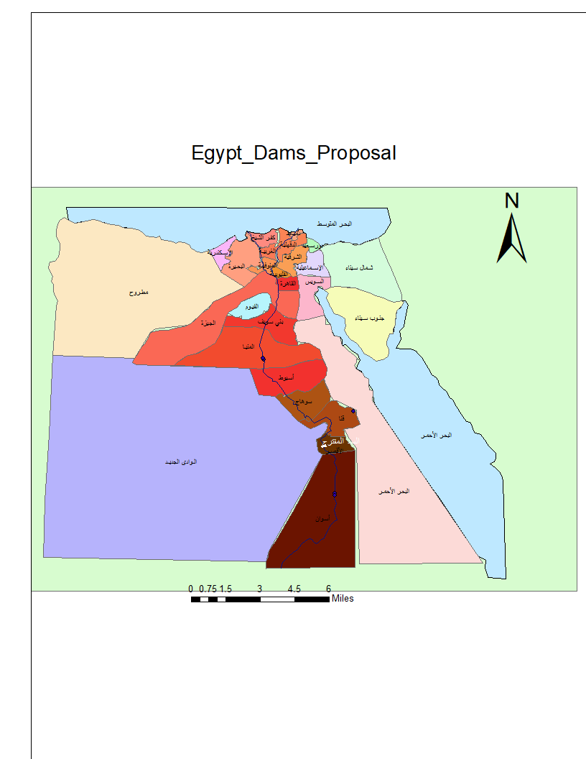
Digital map

Slide 10
THANK YOU
LinkedIn

